Slide 1
WELCOME
Business Workshop

Slide 2
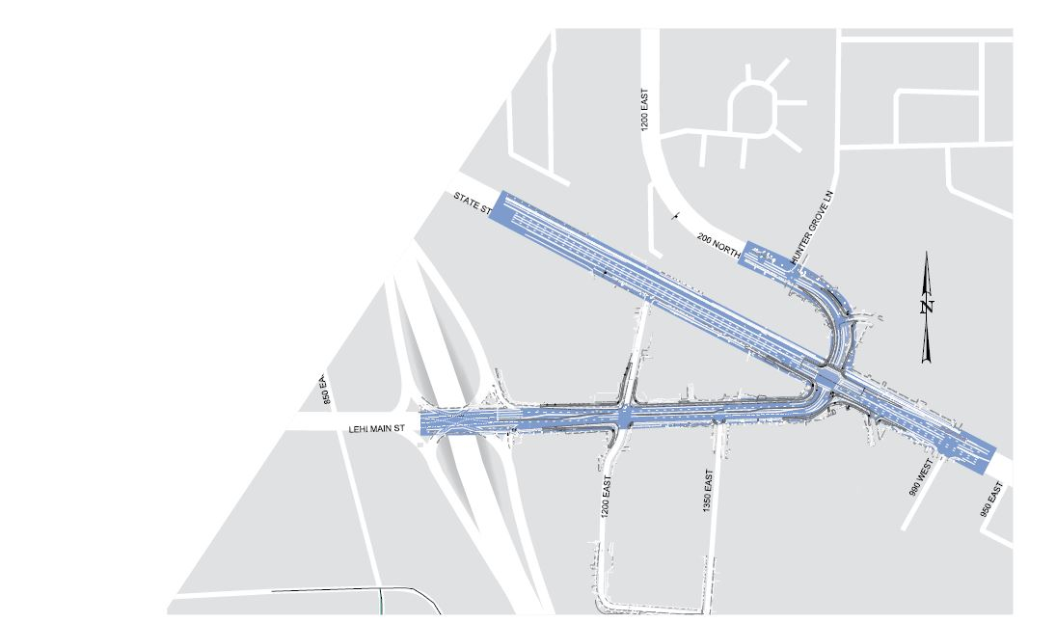
OVERVIEW
Work begins April 9, 2018; lasts through early July
Main Street widening (I-15 to State Street)
New traffic signal at Main Street and 1200 East
Traffic signal upgrade and railroad crossing at Main Street and State Street
Raised medians on Main Street
Notes:
Utility work possible as early as April 2
100 calendar days
Main Street
Additional lane in each direction (with center median)
New signal at 1200 East (corner of Holiday Oil)
Median (break at 1350 East)
Double through lanes headed EB to 1200 East
Free right onto State St.
1200 East/State Street
- Double left turn lanes to head south on State

Slide 3
WHAT TO EXPECT
Daytime and nighttime shifts, seven days a week
Nightly lane closures:
Monday through Thursday: 8 p.m. – 6 a.m.
Friday through Sunday: 10 p.m. – 6 a.m.
Occasional noise, dust or vibration
Restriping Main Street; shifting traffic south
Notes:
All lanes open during daylight hours
Single lane closures in both directions overnight
Three phases:
North side of Main
South side of Main
East of State
Restriping and shifting lanes on Main Street to work

Slide 4
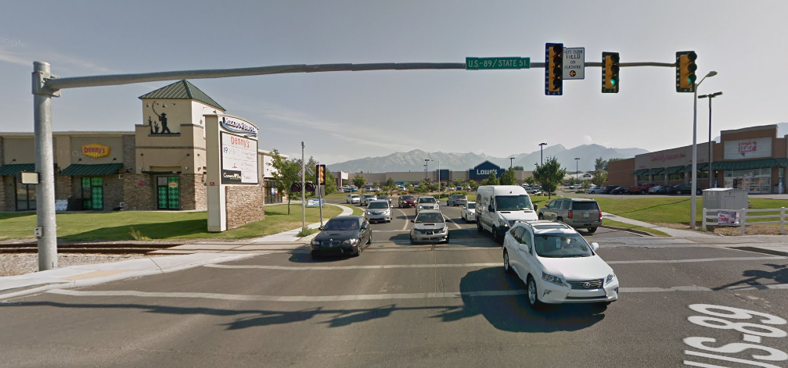
1200 EAST CLOSURE
Four-day road closure at railroad tracks east of State Street to Hunter Grove Lane
Replacing tracks and concrete pads
Early May
Notes:
Point out recommended routes during closure – show on Google map image
900 East/900 West (entrance for businesses)
Notification to residents and businesses
Work to take place during closure:
Storm drain crossing and road excavation near Eastgate & mill/fill on State St.
1200 East carries 12-13K cars per day (20,000 right at intersection)
Work with Wade on EMS/community outreach
Additional VMS
PI outreach/coordination
Detouring cars to

Slide 5
PHASING
Three concurrent phases:
North side of Main Street
South side of Main Street
East of State Street
First tasks:
Utilities moved back east of State Street
Signal at 1200 East
Notes:
Three phases/four crews:
North side of Main
South side Main
East of State
First tasks:
East side of State completed first
Utilities moved back
Everything in 25’ of RR done
Signal at 1200 East – starting immediately
RMP
Lehi to move pedestal
RMP to do boring in front of Conoco
Bases for 73 and state signal – starts early; lasts length of project
Bases first & conduit
Toward the end for switches themselves

Slide 6
BUSINESS ACCESS
Half of each driveway must remain open at all times
Work will not take place concurrently on two driveways servicing the same business
Driveway impacts will be restricted to a maximum of 10 calendar days per half
Signs will be provided to show that businesses are accessible and open during construction
Notes:
All businesses will be accessible during business hours
Proactive communication/outreach week prior to closure

Slide 7
CONTACT
HOTLINE 385-275-2111
EMAIL
EMAIL udotregion3@utah.gov
WEBSITE udot.utah.gov/go/lehimainstreet
For the latest information on traffic restrictions during construction, visit the UDOT Traffic website (udottraffic.utah.gov).
Notes:
24/7 Hotline
Contact project team with questions/concerns
Katie, Courtney, Brandie will coordinate with UDOT/Contractor

Slide 8
Contact
April 2018 – late 2020
180-day full closure of 600 East begins May 2018
HOTLINE 844-401-TECH(8824)
EMAIL techcorridor@utah.gov
TWITTER @i15techcorridor
WEBSITE udot.utah.gov/go/lehimainstreet
Notes:
Adjacent project information
Traffic re-routing to Main St. during 600 East bridge closure
Same public outreach team – 24/7 hotline listed

